Slide 1

Natural Language Processing
Sentiment Analysis -
AfriSenti Twitter Sentiment dataset
MASTER OF SCIENCE OF INFORMATION SYSTEMS
INTELLIGENT SYSTEMS
STUDENTS (GROUP2) | AINEDEMBE DENIS 2024-M132-23999
 | MUSINGUZI BENSON 2024-M132-23947
LECTURER | Dr. Sibitenda Harriet

Slide 2


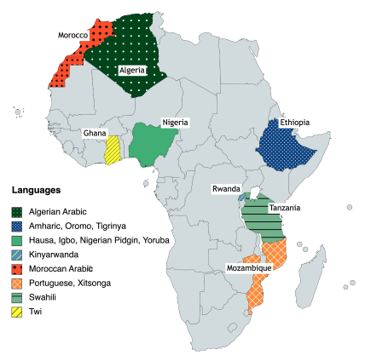
About the AfriSenti Twitter Sentiment Dataset
The dataset contains 110,000+ annotated tweets across 14 African languages; Amharic, Algerian Arabic, Hausa, Igbo, Kinyarwanda, Mozambican Portuguese, Nigerian Pidgin, Oromo, Swahili, Tigrinya, Twi, Xitsonga, Yoruba
Tweets are labeled by three annotators into three sentiment categories: Positive, Negative, Neutral
All tweets are anonymized (@user) and URLs removed to protect user privacy
Designed for Monolingual and multilingual and sentiment analysis, supporting research on African languages which are underrepresented in NLP.
Why this dataset matters:
African languages make up 30% of the world’s languages, yet lack NLP datasets (UNESCO) - AfriSenti fills this gap
References:
Codalab: https://codalab.lisn.upsaclay.fr/competitions/7320 ,
Hugging Face: https://huggingface.co/datasets/HausaNLP/AfriSenti-Twitter
ACL Anthology: https://aclanthology.org/2023.emnlp-main.862.pdf

Slide 3
Project Objectives
Main Objective
To build and evaluate a multilingual sentiment analysis model that classifies African-language tweets into positive, negative, or neutral sentiment.
Specific Objectives
Explore the dataset: Analyze language distribution, tweet length, and sentiment label imbalance.
Preprocess the text: Clean tweets, remove URLs, normalize slang, and tokenize using mBERT or XLM-RoBERTa.
Model Development: Fine-tune XLM-RoBERTa for 3-class sentiment classification and compare with an LSTM baseline.
Model Training: Use early stopping and gradient clipping for 3–5 epochs to prevent overfitting.
Evaluation: Measure Accuracy, Macro-F1, ROC-AUC, and produce a confusion matrix. Include example predictions and attention visualization.
Ablation Studies: Vary batch size, learning rate, and sequence length to observe performance changes.
Cross-Lingual Testing: Train on one language (e.g., Swahili) - test on another (e.g., Amharic) to assess the model’s multilingual transfer ability.

Slide 4
Real-Life Applicability
1. Social Media Monitoring
Governments, NGOs, and research institutions can track public mood on elections, health, crises, and social issues using multilingual sentiment trends.
2. Customer & Brand Analysis
Businesses can monitor consumer reactions across languages to improve products and services.
3. Hate Speech & Online Safety
Sentiment analysis is a key component in detecting negative or harmful content, especially in multilingual online spaces.
4. Policy & Public Opinion Research
Analysts can understand public attitudes in African countries/languages that are often ignored due to lack of datasets.
5. Enhancing African NLP Tools
AfriSenti supports the development of digital tools for African languages, promoting inclusive and equitable AI technology
6. Cross-Lingual AI Applications
Your cross-lingual experiments contribute to systems that work even when certain languages lack large datasets.

Slide 5
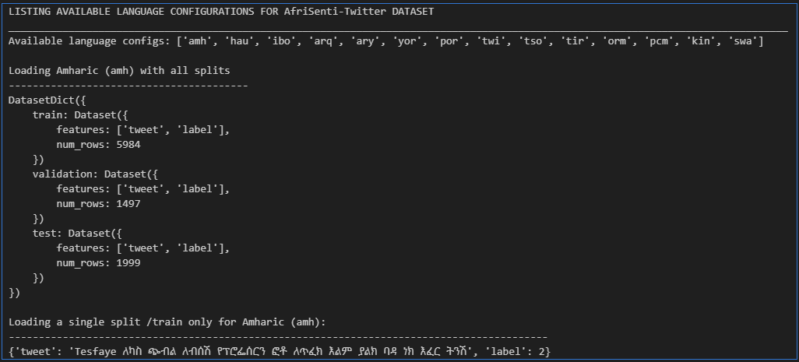
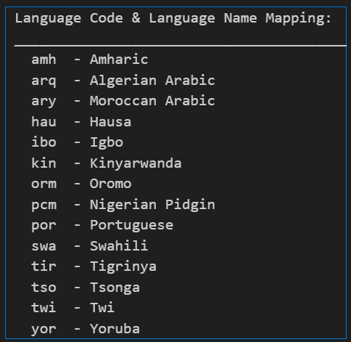
Loading AfriSenti-Twitter Dataset: Listing Available Language Configurations

Slide 6
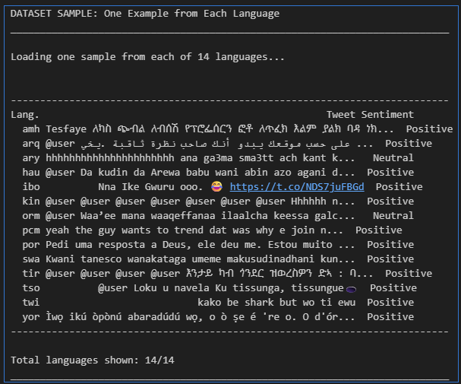
Loading the AfriSenti Twitter Sentiment dataset
Collect one example from each language
Label mapping: 0=negative, 1=neutral, 2=positive
Truncate tweet to 50 characters for better display

Slide 7
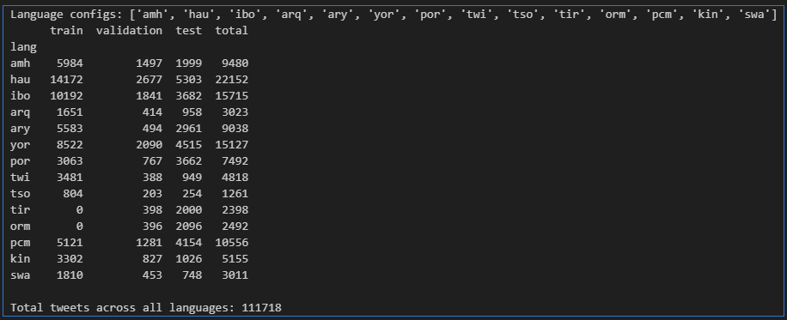
AfriSenti Twitter dataset: Total tweets across all languages

Slide 8
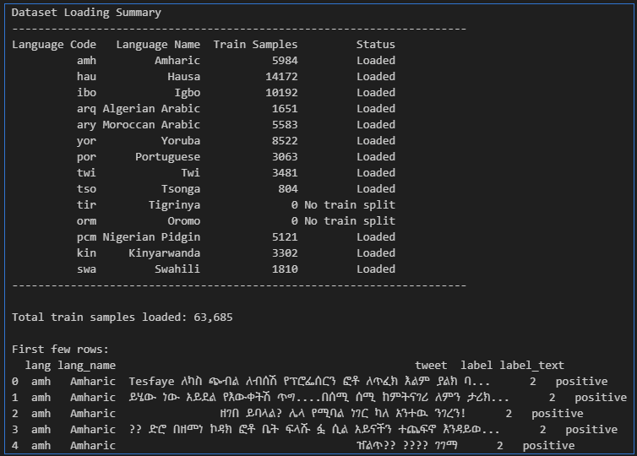
Initial Data Exploration: Load train data from all languages

Slide 9
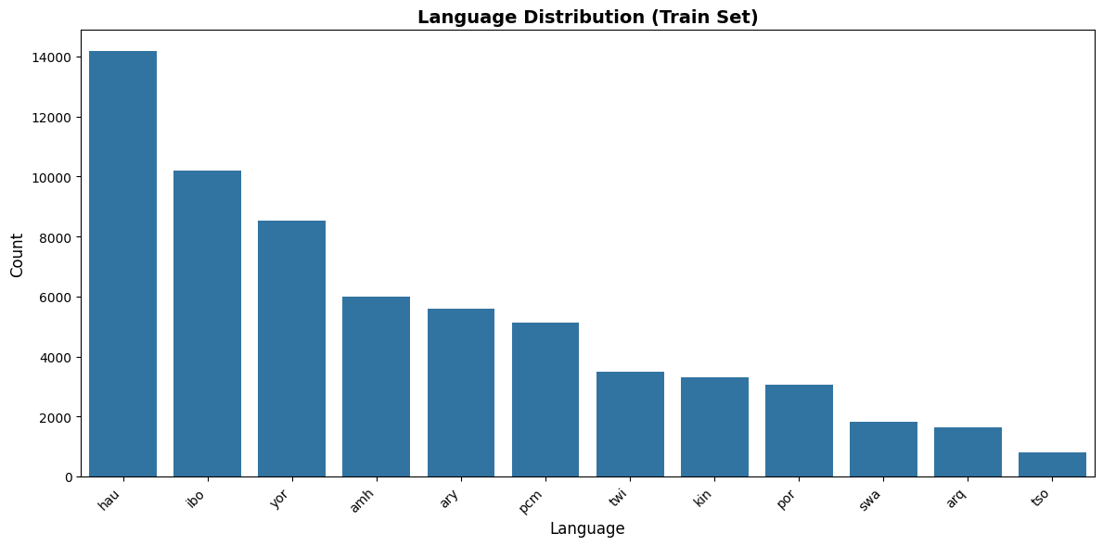
Initial Data Exploration: Language Distribution on the Train Set
lang | counts
hau | 14,172
ibo | 10,192
yor | 8,522
amh | 5,984
ary | 5,583
pcm | 5,121
twi | 3,481
kin | 3,302
por | 3,063
swa | 1,810
arq | 1,651
tso | 804

Slide 10
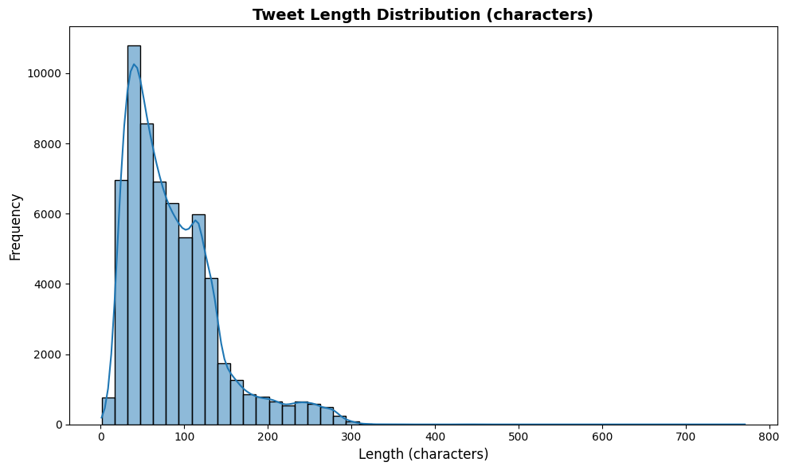
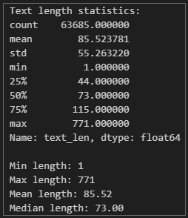
Initial Data Exploration: Text length Distribution the Train Set
The training tweets are mostly short (median 73 characters), with a right-skewed distribution and a few very long outliers.
The data is concise and typical of Twitter usage, making it suitable for transformer models with moderate sequence lengths

Slide 11
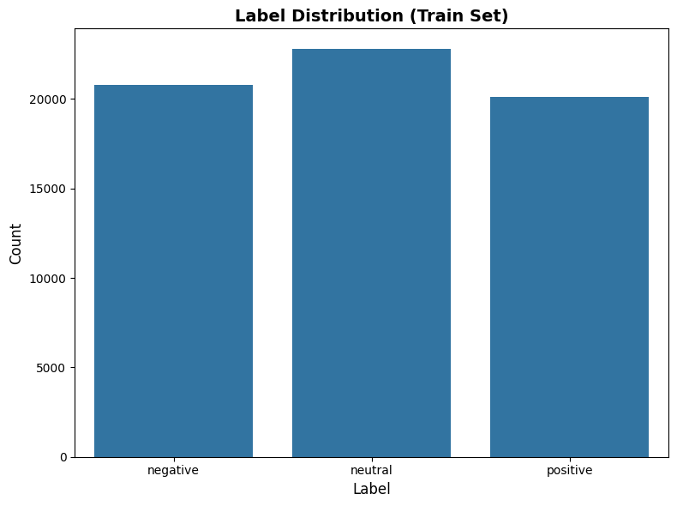
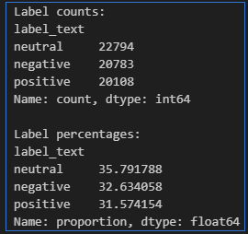
Initial Data Exploration: Overall Label Distribution
The train set shows a well-balanced label distribution with 36% neutral, 33% negative, and 32% positive tweets. Thes observed balance supports stable model training without the need for class reweighting.

Slide 12
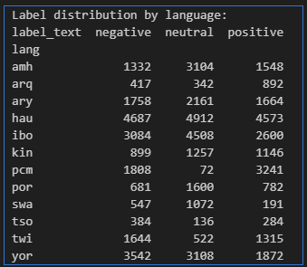
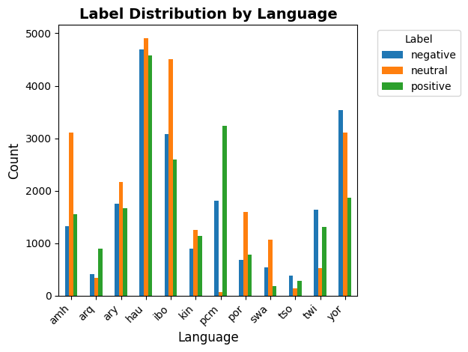
Initial Data Exploration: Label Distribution by Language
1) Sentiment distribution varies significantly across languages
2) Shome languages like (Hausa, Igbo, and Yoruba) are balanced, others (e.g., Nigerian Pidgin and Twi) show extreme skewness in one sentiment class.
3) Potential challenges for model training and emphasizes the importance of multilingual transfer and careful evaluation

Slide 13

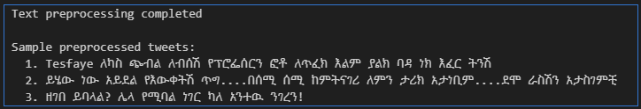
Preprocess text using multilingual tokenizers (mBERT, XLM-RoBERTa)
Load train, validation, and test datasets from all languages
Text preprocessing. Handled emojis, URLs, and slang normalization.
URLs
Mentions <USER>
Normalize whitespace
Remove # but keep word

Slide 14
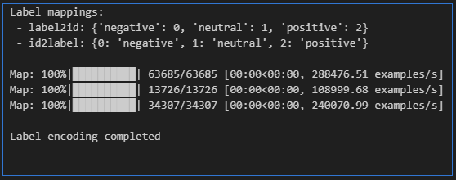
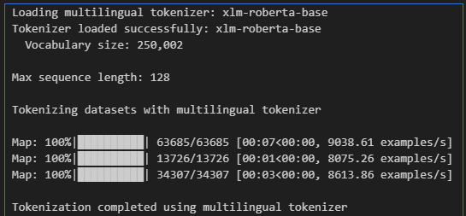
Preprocess text: Label mapping & tokenizing Tweets Using XLM-RoBERTa
Label mapping:
string -> int
(0=negative, 1=neutral, 2=positive)
Tokenizing Tweets
Using multilingual tokenizer
XLM-RoBERTa

Slide 15
  Modeling
  Fine-tune XLM-RoBERTa for 3-class sentiment classification
  (positive, neutral, negative).
  Compare with
  LSTM baseline Model

Slide 16
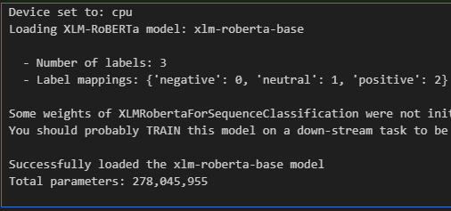
XLM-RoBERTa Transformer Model
Total parameters:
278,045,955

Slide 17
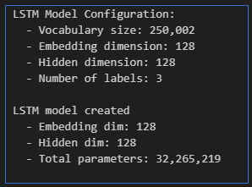
LSTM Baseline Model
Total parameters:
32,265,219

Slide 18
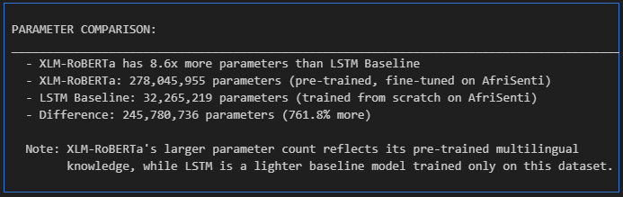
Comparison: XLM-RoBERTa vs LSTM Baseline

Slide 19
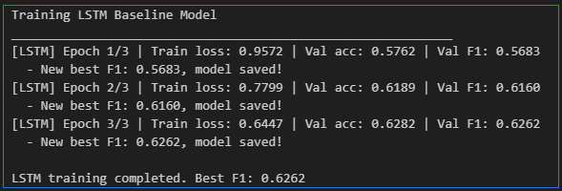
Training Models - 5 epochs with Early stopping + Gradient clipping)
Training LSTM Baseline Model with early stopping

Slide 20
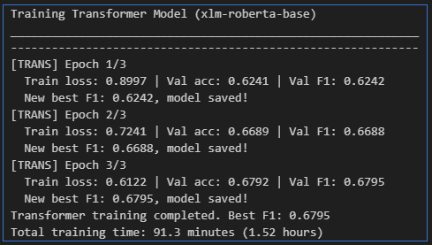
Training Models - 5 epochs with Early stopping + Gradient clipping)
Training XLM-RoBERTa or AfriBERTa Model with early stopping

Slide 21
  Evaluation (F1, Accuracy, ROC-AUC, Confusion Matrix) + Predictions & Attention
  Evaluating both LSTM and XLM-RoBERTa models on test data with comprehensive metrics, example predictions, and attention visualization.

Slide 22
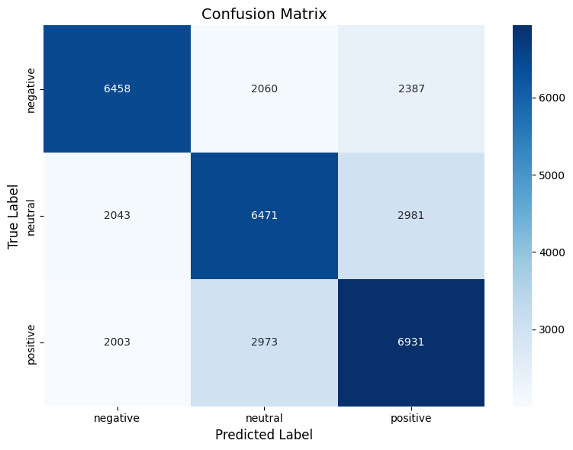
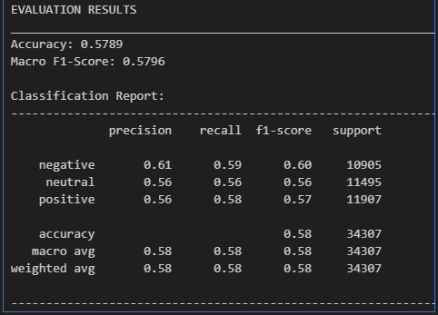
Evaluating LSTM Baseline Model on Test Set
Macro F1-Score: 0.5796
Macro ROC-AUC: 0.7590

Slide 23
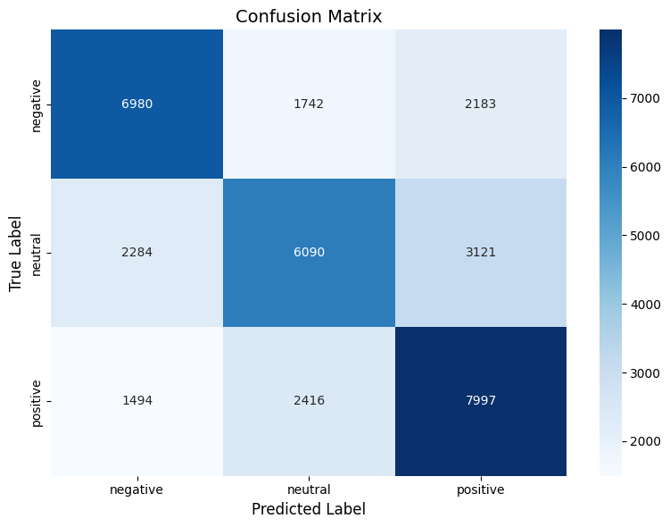
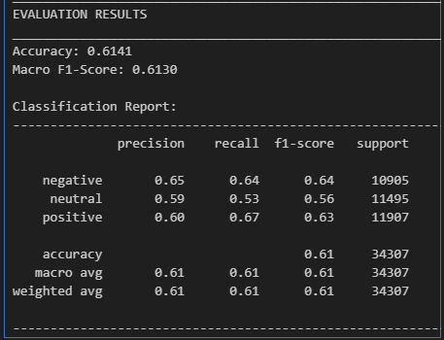
Evaluating XLM-ROBERTA Transformer Model on Test Set
Macro F1-Score: 0.6130
Macro ROC-AUC: 0.7976

Slide 24
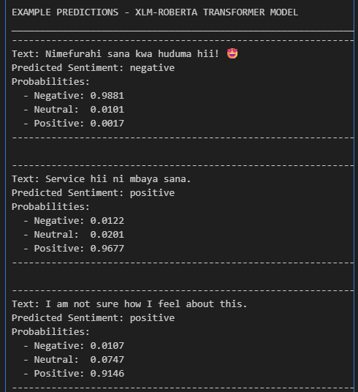
Predictions on Sample Texts do demonstrate model Behavior on Different Languages and Sentiment Classes

Slide 25
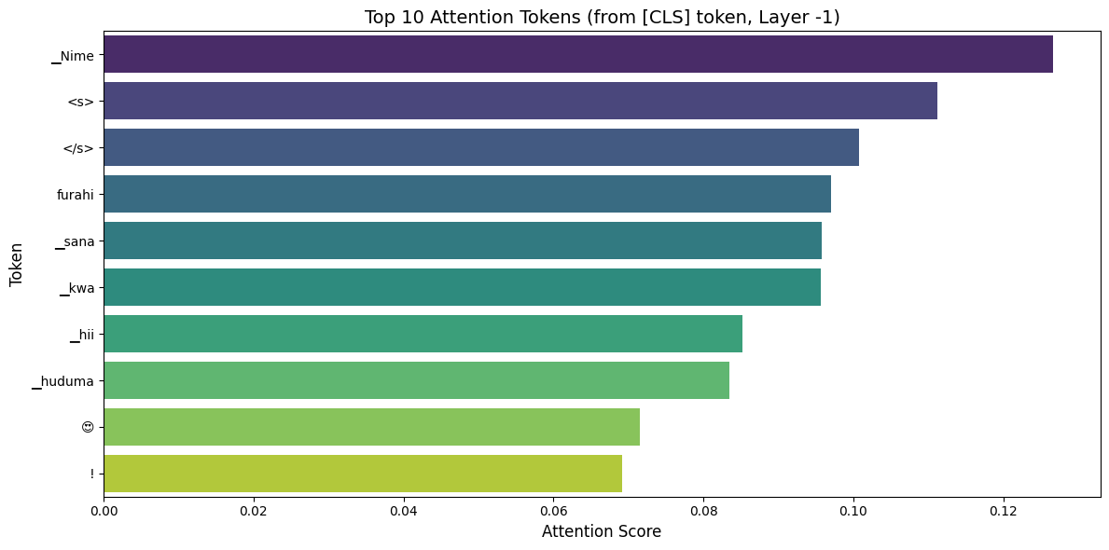
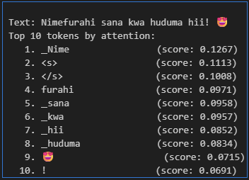
Attention Visualization XLM-ROBERTA Transformer Model

Slide 26
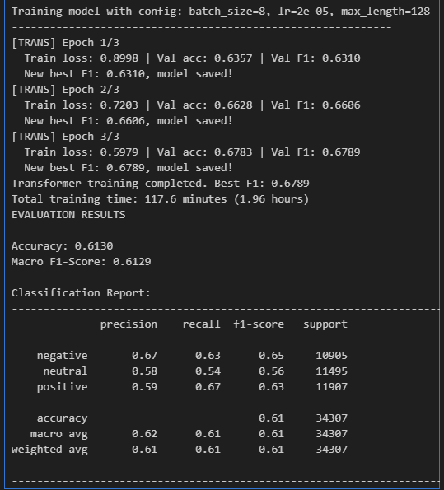

Ablation Studies (Batch Size, Learning Rate, Sequence Length)
NOTE: This study did not complete due to GPU Limits

Slide 27
NOTE:
We did not test this section due to GPU Limits
Cross-Lingual Testing:
Multiple Language Pairs
Test cross-lingual transfer with multiple language pairs:
Train on Swahili, Test on Amharic
Train on Swahili, Test on Pidgin English (pcm)
Testing the model's ability to transfer knowledge across languages by training on one language (Swahili) and evaluating on different target languages.

Slide 28
THE END
STUDENTS | AINEDEMBE DENIS +256 788-674576 dembedenisjb@gmail.com, ainedembe.denis@stud.umu.ac.ug
 | MUSINGUZI BENSON +256 782 942245, musiben@gmail.com, musinguzi.benson@stud.umu.ac.ug
LECTURER | Dr. Sibitenda Harriet +256 777 056581 hsibitenda@umu.ac.ug

